Slide 1
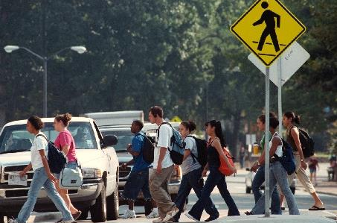
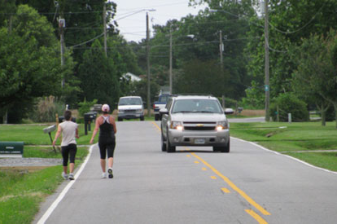
Road Safety Management for Pedestrians and Bicyclists
Offer Grembek
Co-Director, UC Berkeley, SafeTREC
Presented at
School of Transportation Engineering, Tongji University
October 26, 2015

Slide 2
Research Collaborators
UC Berkeley
Offer Grembek, PhD
David Ragland, PhD, MPH
Julia Griswold, PhD
Aditya Medury, PhD
Yuanyuan Zhang, PhD
Frank Proulx
Jessica Nguyen
Semich Chousein
University of Minnesota
Robert Schneider, PhD
Tongji University
Junhua Wang, PhD
Ying Ni, PhD

Slide 3
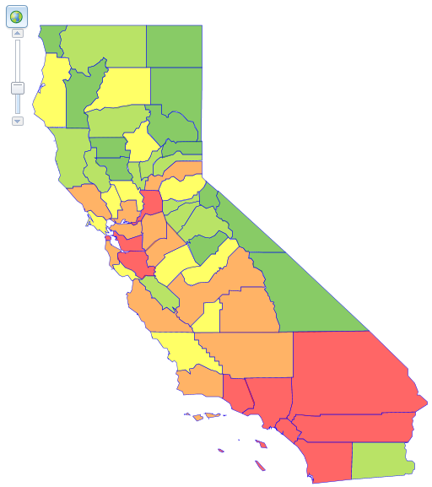
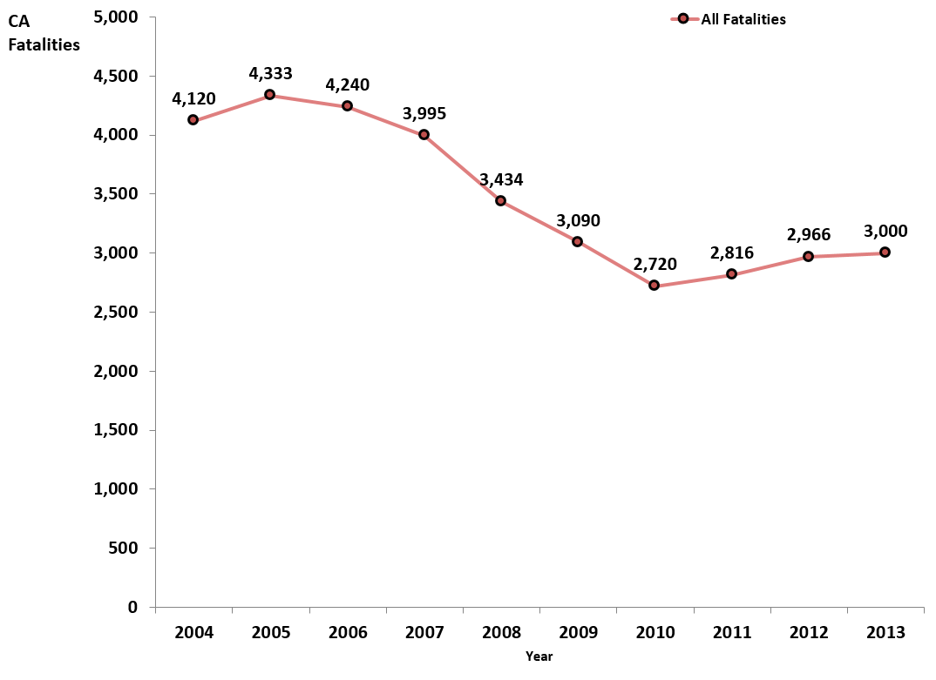
The Traffic Safety Problem in CA
Facts and Figures
Over 34,000 traffic fatalities in the past 10 years.
2013 Figures
3,000 fatalities
33%↓
* Source: Fatality Analysis Reporting System (FARS), NHTSA
* Source: Fatality Analysis Reporting System (FARS), NHTSA

Slide 4
The Traffic Safety Problem in CA
Facts and Figures
Over 34,000 traffic fatalities in the past 10 years.
Since 2010 (end of recession) there is a 10% increase in fatalities
2013 Figures
3,000 fatalities
33%↓
10%↑
* Source: Fatality Analysis Reporting System (FARS), NHTSA
* Source: Fatality Analysis Reporting System (FARS), NHTSA

Slide 5
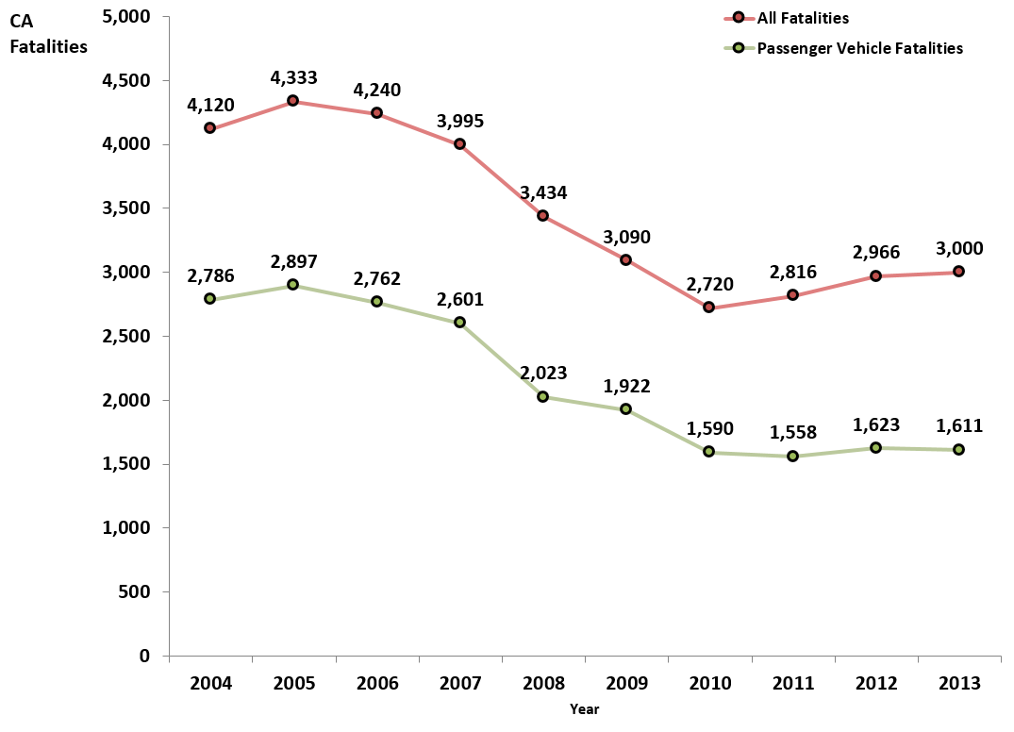
Passenger Vehicle Fatalities
Facts and Figures
Over 21,000 passenger vehicle fatalities in the past 10 years.
2013 Figures
1,611 fatalities
10%↑
* Source: Fatality Analysis Reporting System (FARS), NHTSA

Slide 6
Passenger Vehicle Fatalities
Facts and Figures
Over 21,000 passenger vehicle fatalities in the past 10 years.
Since 2010 (end of recession) there is a 1% increase in passenger vehicle fatalities
2013 Figures
1,611 fatalities
10%↑
1%↑
* Source: Fatality Analysis Reporting System (FARS), NHTSA

Slide 7
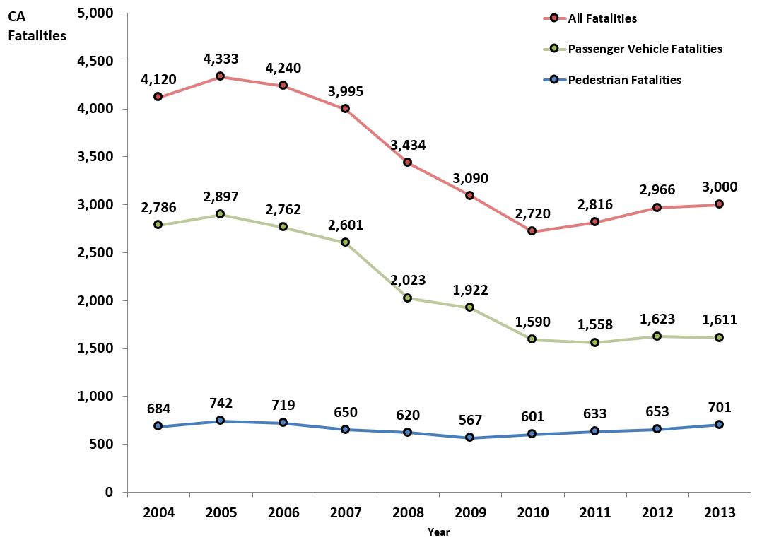
Pedestrian Fatalities Increased
Facts and Figures
Over 6,500 pedestrian fatalities in the past 10 years.
2013 Figures
701 fatalities
10%↑
1%↑
* Source: Fatality Analysis Reporting System (FARS), NHTSA

Slide 8
Pedestrian Fatalities Increased
Facts and Figures
Over 6,500 pedestrian fatalities in the past 10 years.
Since 2010 (end of recession) there is a 17% increase in pedestrian fatalities
2013 Figures
701 fatalities
10%↑
1%↑
17%↑
* Source: Fatality Analysis Reporting System (FARS), NHTSA

Slide 9
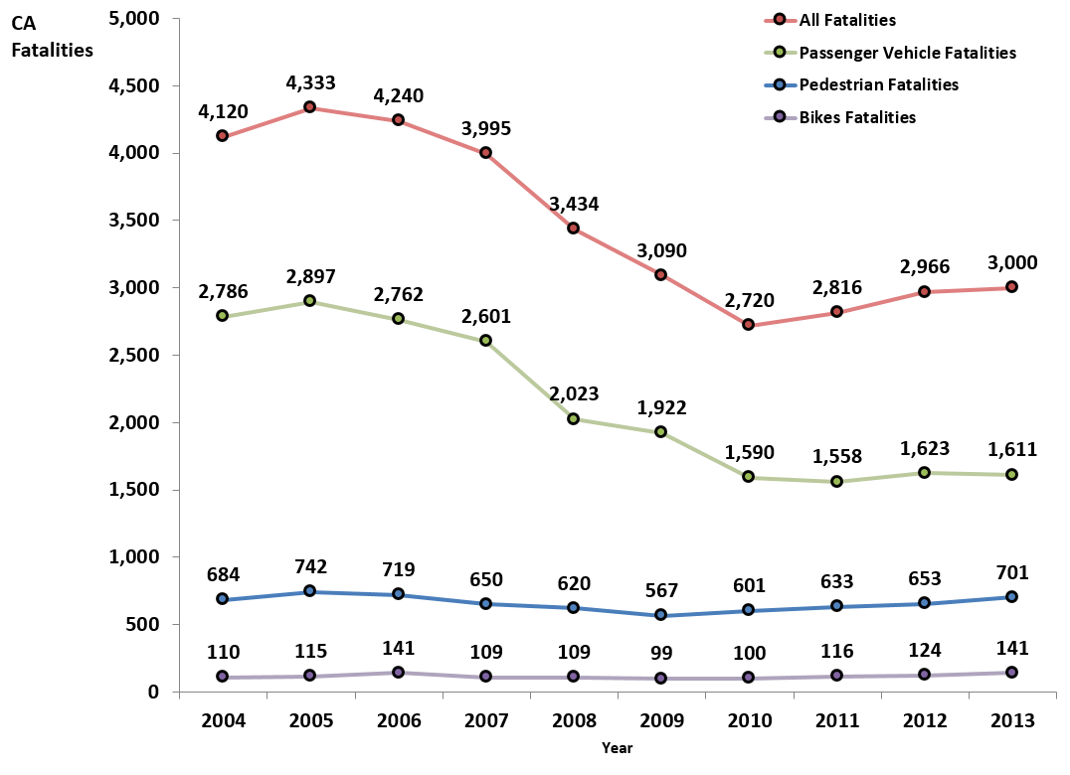
Bicycle Fatalities Increased
Facts and Figures
Over 1,100 pedestrian fatalities in the past 10 years.
2013 Figures
141 fatalities
10%↑
1%↑
17%↑
* Source: Fatality Analysis Reporting System (FARS), NHTSA

Slide 10
Bicycle Fatalities Increased
Facts and Figures
Over 1,100 pedestrian fatalities in the past 10 years.
Since 2010 (end of recession) there is a 41% increase in bicycle fatalities
2013 Figures
141 fatalities
10%↑
1%↑
17%↑
41%↑
* Source: Fatality Analysis Reporting System (FARS), NHTSA

Slide 11
P/B Fatalities are Increasing
While passenger vehicles fatalities remained the same,
pedestrian and bicycle fatalities have increased significantly over the past four years.
10%↑
1%↑
17%↑
41%↑
* Source: Fatality Analysis Reporting System (FARS), NHTSA

Slide 12
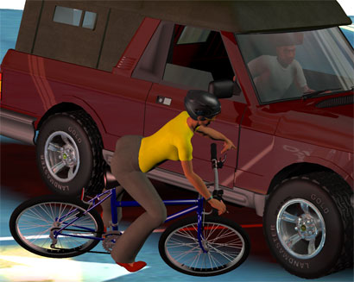
Relative Vulnerability in Traffic

Slide 13
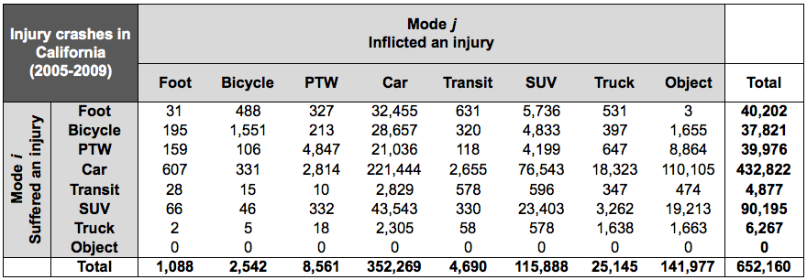
The Vulnerability Matrix
Table from Grembek (2010)
* SWITRS 2005-2009, Injury crashes of two parties or less.

Slide 14
The Vulnerability Matrix
Table from Grembek (2010)
* SWITRS 2005-2009, Injury crashes of two parties or less.

Slide 15
The Vulnerability Matrix
Table from Grembek (2010)
* SWITRS 2005-2009, Injury crashes of two parties or less.

Slide 16
The Vulnerability Matrix
Table from Grembek (2010)
* SWITRS 2005-2009, Injury crashes of two parties or less.

Slide 17
The Vulnerability Matrix
Table from Grembek (2010)
* SWITRS 2005-2009, Injury crashes of two parties or less.

Slide 18
The Vulnerability Matrix
Table from Grembek (2010)
* SWITRS 2005-2009, Injury crashes of two parties or less.

Slide 19
The Vulnerability of Pedestrians
Table from Grembek (2010)
* SWITRS 2005-2009, Injury crashes of two parties or less.
40,202
1,088
= 36.95 – Relative vulnerability of pedestrians in the CA network
In other words: pedestrians suffer 36.95 times more injuries than they inflict.

Slide 20
The Vulnerability of Bicyclists
Table from Grembek (2010)
* SWITRS 2005-2009, Injury crashes of two parties or less.
37,821
2,542
= 14.88 – Relative vulnerability of bicyclists in the CA network
In other words: pedestrians suffer 14.88 times more injuries than they inflict.

Slide 21
P/B are the Most Vulnerable
Tables from Grembek (2010)

Slide 22
Safety is Obtained by Buffers
Passenger Vehicles
Environment
Industry
Road User

Slide 23
Safety is Obtained by Buffers
Passenger Vehicles
Environment
Industry
Road User
Pedestrians and Bikes
Environment
Road User
Industry

Slide 24
Limited P/B Industry Safety Buffer
Passenger Vehicles
Environment
Industry
Road User
Pedestrians and Bikes
Environment
Road User
Industry

Slide 25
Principles of Road Safety Management
 | 1 | 2
3 | 4 | 5
6 | 7 | 8
A set of goals and activities to improve P/B safety | Infrastructure data | Exposure data
Data Evaluation | Hazard Assessment | Countermeasure Selection
Economic Appraisal | Funding Sources | Institutionalization

Slide 26
Principles of Road Safety Management
 | 1 | 2
3 | 4 | 5
6 | 7 | 8
A set of goals and activities to improve P/B safety | Infrastructure data | Exposure data
Data Evaluation | Hazard Assessment | Countermeasure Selection
Economic Appraisal | Funding Sources | Institutionalization

Slide 27
Principles of Road Safety Management
 | 1 | 2
3 | 4 | 5
6 | 7 | 8
A set of goals and activities to improve P/B safety | Infrastructure data | Exposure data
Data Evaluation | Hazard Assessment | Countermeasure Selection
Economic Appraisal | Funding Sources | Institutionalization

Slide 28
Principles of Road Safety Management
 | 1 | 2
3 | 4 | 5
6 | 7 | 8
A set of goals and activities to improve P/B safety | Infrastructure data | Exposure data
Data Evaluation | Hazard Assessment | Countermeasure Selection
Economic Appraisal | Funding Sources | Institutionalization

Slide 29
Principles of Road Safety Management
 | 1 | 2
3 | 4 | 5
6 | 7 | 8
A set of goals and activities to improve P/B safety | Infrastructure data | Exposure data
Data Evaluation | Hazard Assessment | Countermeasure Selection
Economic Appraisal | Funding Sources | Institutionalization

Slide 30
Principles of Road Safety Management
 | 1 | 2
3 | 4 | 5
6 | 7 | 8
A set of goals and activities to improve P/B safety | Infrastructure data | Exposure data
Data Evaluation | Hazard Assessment | Countermeasure Selection
Economic Appraisal | Funding Sources | Institutionalization

Slide 31
Principles of Road Safety Management
 | 1 | 2
3 | 4 | 5
6 | 7 | 8
A set of goals and activities to improve P/B safety | Infrastructure data | Exposure data
Data Evaluation | Hazard Assessment | Countermeasure Selection
Economic Appraisal | Funding Sources | Institutionalization

Slide 32
Principles of Road Safety Management
 | 1 | 2
3 | 4 | 5
3 | 7 | 8
A set of goals and activities to improve P/B safety | Infrastructure data | Exposure data
Data Evaluation | Hazard Assessment | Countermeasure Selection
Economic Appraisal | Funding Sources | Institutionalization

Slide 33
Principles of Road Safety Management
 | 1 | 2
3 | 4 | 5
3 | 7 | 8
A set of goals and activities to improve P/B safety | Infrastructure data | Exposure data
Data Evaluation | Hazard Assessment | Countermeasure Selection
Economic Appraisal | Funding Sources | Institutionalization

Slide 34
Principles of Road Safety Management
 | 1 | 2
3 | 4 | 5
6 | 7 | 8
A set of goals and activities to improve P/B safety | Infrastructure data | Exposure data
Data Evaluation | Hazard Assessment | Countermeasure Selection
Economic Appraisal | Funding Sources | Institutionalization

Slide 35
Principles of Road Safety Management
 | 1 | 2
3 | 4 | 5
6 | 7 | 8
A set of goals and activities to improve P/B safety | Infrastructure data | Exposure data
Data Evaluation | Hazard Assessment | Countermeasure Selection
Economic Appraisal | Funding Sources | Institutionalization

Slide 36
Facility decomposition

Slide 37
Elements and core facilities
Sidewalk
Buffer
Approach
Median
Crosswalk
Intersection
Approach
Buffer
Sidewalk

Slide 38
Define an approach
A1
N1
N2
A2

Slide 39
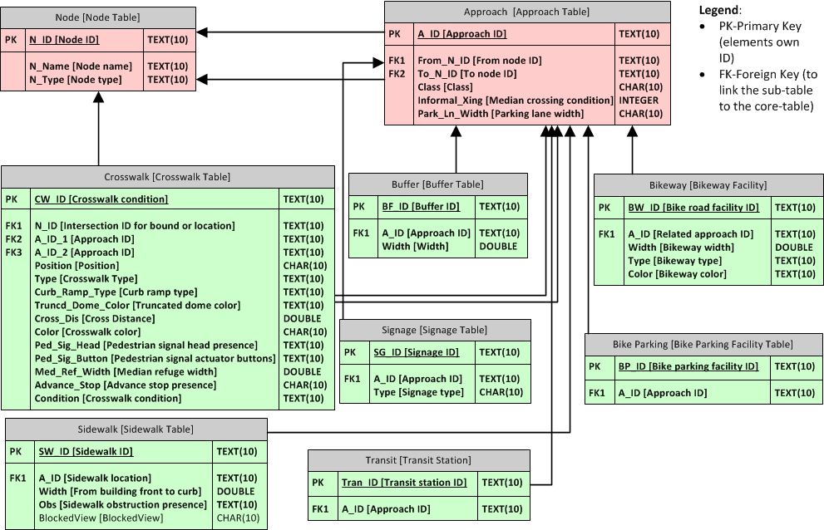
Formal Infrastructure Database
Notes:
If we realize this structure into the database, we can see there are two core tables recording each node and approach, in the red box. And all the other sub-tables will link to the two red tables through the foreign key. For example, the foreign key in a buffer is the approach ID for that buffer. And you can find the approach ID in the approach table.

Slide 40
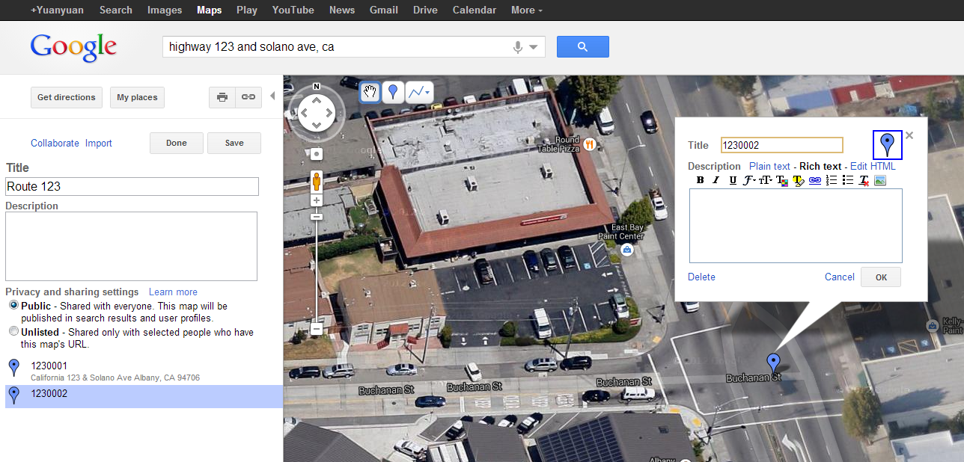
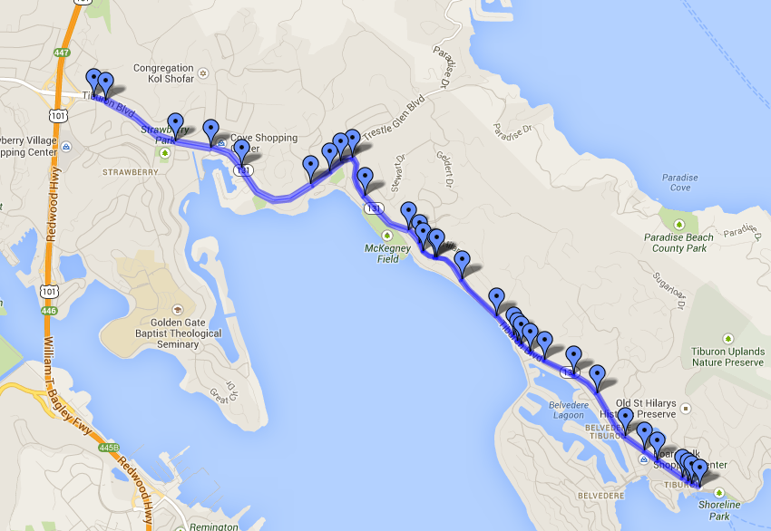
Labeling nodes and approaches
Notes:
The nodes includes intersections, segment breaks, underpass/overpass; approaches are segments connect nodes in different travel directions. They are the basic components in the database, onto which other elements are connected. Create a new map in google maps. Name the map, add points at the location of the nodes, new lines along the segments. Then name them in 7 digits, first 3 for route name and left 4 digits for squence.

Slide 41
Computer data collection
Notes:
To conduct the work more efficienctly, we use double screen. One is to navigate in the map, the other is to input the data.

Slide 42
Principles of Road Safety Management
 | 1 | 2
3 | 4 | 5
6 | 7 | 8
A set of goals and activities to improve P/B safety | Infrastructure data | Exposure data
Data Evaluation | Hazard Assessment | Countermeasure Selection
Economic Appraisal | Funding Sources | Institutionalization

Slide 43
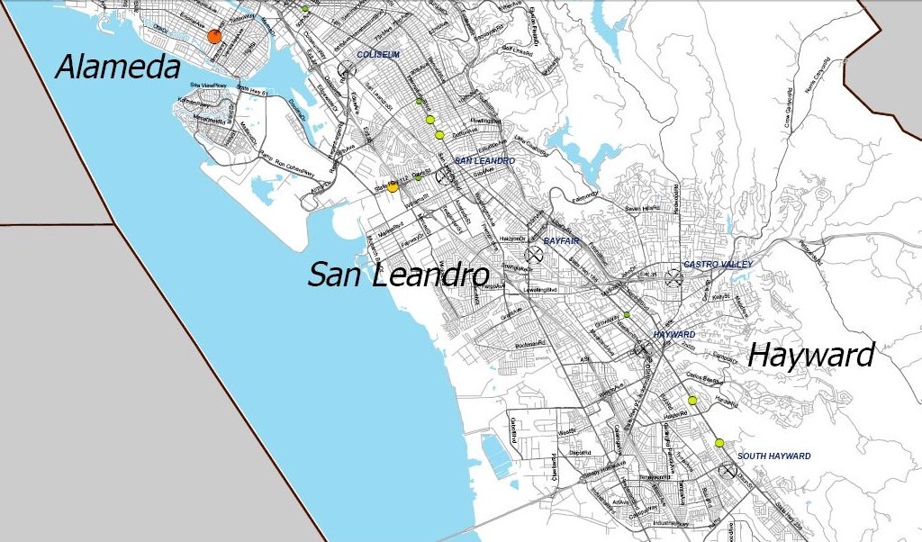
Pedestrian Crashes
Absolute Number of Crashes

Slide 44
Pedestrian Crashes
Absolute Number of Crashes

Slide 45
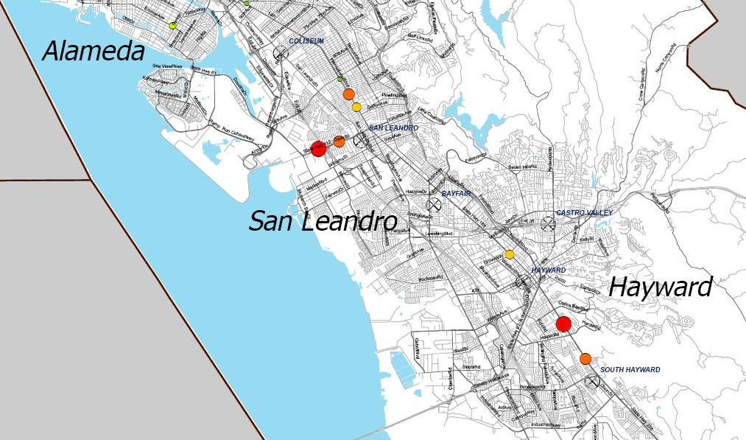
Pedestrian Crash Risk
Crash Risk:
(Crashes / Exposure)

Slide 46
Pedestrian Crash Risk
Crash Risk:
(Crashes / Counts)

Slide 47
Why model pedestrian exposure?
1000s of intersections in the SHS
Data collection at all intersections is impractical
Model can provide estimates for locations without counts

Slide 48
Pedestrian exposure can be modelled using regression
Pedestrian Exposure =
f(Environmental Characteristics)

Slide 49
Dependent Variable: pedestrian crossing counts
Explanatory Variables:
Land Use: population, households, school, businesses
Transportation: street network, design, infrastructure
Other: vehicle ownership, slope

Slide 50
Site-level explanatory variables
Number of Lanes
Traffic signal
AADT

Slide 51
Buffer-level explanatory variables
0.5 mi.

Slide 52
Buffer-level explanatory variables
Street Connectivity = Number of street segments

Slide 53
Buffer-level explanatory variables
Land Use -Number of households

Slide 54
Pilot model based on 60 observations
Estimated annual crossings at urban arterials =
exp (0.00364 × number of households within 0.1 miles
+ -7.17×10⁻⁵ × total AADT
+ 8.96×10⁻¹⁰ × total AADT²
+ 0.367 × number of lanes on cross street
+ 12.5)
Adjusted R-square = 0.85

Slide 55
Full model is being developed
429 studies
5,200+ hours of counts
270+ unique locations

Slide 56
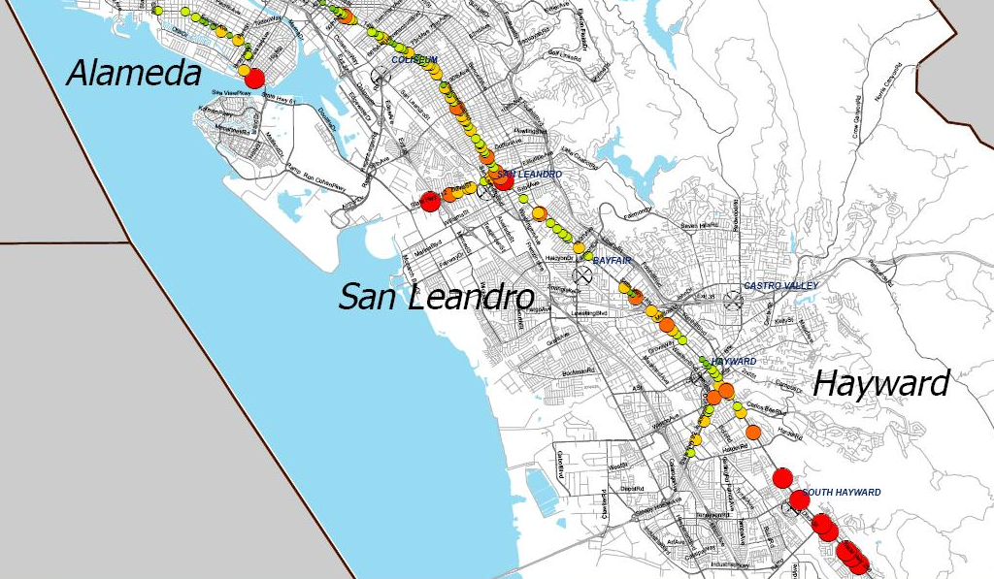
Calculate Pedestrian Crash Risk
Estimate risk at locations without counts

Slide 57
Principles of Road Safety Management
 | 1 | 2
3 | 4 | 5
6 | 7 | 8
A set of goals and activities to improve P/B safety | Infrastructure data | Exposure data
Data Evaluation | Hazard Assessment | Countermeasure Selection
Economic Appraisal | Funding Sources | Institutionalization

Slide 58
Hazard Assessment
Spot Approach
Systemic Approach
Hotspots or High Collision Concentration Locations (HCCL) are road segments with a higher than expected number of crashes, compared to prior experience or a user-defined threshold.
Systemic approach identifies a set of locations where countermeasures may be installed systemically where roadway facilities share the same unsafe features that are associated with particular crash types.

Slide 59
Systemic Approach vs. Spot Approach
Benefits
Complement the hotspot approach
Reduced data needs
Widespread effect
Crash type prevention
Cost‐effectiveness
Drawbacks
Justifying blanket improvements can be difficult

Slide 60
Elements of HCCL Identification
Input: Collision Data
TSAR Files
Pedestrian Safety Monitoring Report (PSMR) Tool
Filtering relevant collisions
Location types, party types, years, etc.
Algorithms to identify HCCLs
Selection criteria:
maximum window length, minimum number of collisions
Starting and ending postmiles, total number of collisions, other supplementary information
Generating a list of HCCLs

Slide 61
Illustrative Example
Maximum window length (w): 0.1 miles
Minimum crash threshold (n_{min}): 2
Individual Crash Locations
Road network
7
10
1
2
3
4
5
6
8
11
9
0
0.2
0.4
0.6
0.8
1.0
Postmile
Notes:
Let us look at the sliding window approach through a small illustrative example.
Here, we have a road network and shown in grey, and the black circles are the individual crash locations.

Slide 62
0. Dividing the road into equal intervals
Fixed window length (w): 0.1 miles
Minimum number of crashes (n_{min}): 2
Number of HCCLs identified: 5
Total number of crashes covered: 11
7
7
10
1
10
1
2
2
3
3
4
4
5
5
6
6
6
8
8
11
11
9
9
0
0.2
0.4
0.6
0.8
1.0
Postmile
Notes:
- Let us assume that the two user inputs in this case are a (fixed) window length of 0.2 miles, and a threshold of 2 crashes
The crash window is placed by using the first crash as a start point. The resulting road segment covered by the crash window forms the first candidate HCCL location.
We now check the total number of crashes within this road segment, which is 2, which is equal to the crash threshold. Hence this qualifies as a HCCL!
We now move on to the second candidate location, which starts from the next available crash as a start point. Here we have three crashes – so it is a HCCL as well!
The next available crash window only contains one crash – so it is not a HCCL
Finally, the last available crash window contains three crashes – so it is a HCCL
In conclusion, we see that the sliding window approach identified 3 HCCLs which covered 8 crashes between them.

Slide 63
1. Sliding Window
Fixed window length (w): 0.1 miles
Minimum number of crashes (n_{min}): 2
Number of HCCLs identified: 4
Total number of crashes covered: 10
# crashes > n_{cric}
7
7
10
1
10
1
2
2
3
3
4
4
5
5
6
6
8
8
11
11
9
9
First candidate HCCL location
(using the first crash as a start point)
Move to the next candidate HCCL location
(use the next available crash as a start point)
0
0.2
0.4
0.6
0.8
1.0
Postmile
Notes:
- Let us assume that the two user inputs in this case are a (fixed) window length of 0.2 miles, and a threshold of 2 crashes
The crash window is placed by using the first crash as a start point. The resulting road segment covered by the crash window forms the first candidate HCCL location.
We now check the total number of crashes within this road segment, which is 2, which is equal to the crash threshold. Hence this qualifies as a HCCL!
We now move on to the second candidate location, which starts from the next available crash as a start point. Here we have three crashes – so it is a HCCL as well!
The next available crash window only contains one crash – so it is not a HCCL
Finally, the last available crash window contains three crashes – so it is a HCCL
In conclusion, we see that the sliding window approach identified 3 HCCLs which covered 8 crashes between them.

Slide 64
1. Sliding Window
Strength:
Intuitive approach
Weaknesses:
Fixed HCCL length assumption leads to inefficient HCCL definitions for pedestrians
Can we improve upon this definition?
7
7
8
8
9
9
Excessive empty space
Notes:
- The strength of the sliding window approach is that it is an easy, intuitive approach to follow.
However its weakness is that the fixed HCCL length assumption leads to inefficient HCCL definition, as seen below. Here all the three crashes were located at one point location, but the HCCL was still defined over 0.2 miles.
We also believe that pedestrian-vehicle interactions are more localized, i.e., they occur at intersections, mid-blocks and other crosswalks. So it would be more useful to have compact, dense definitions of HCCLs.
So the question is if we can improve upon this definition?

Slide 65
Another weakness of sliding window
Fixed window length (w): 0.1 miles
Minimum number of crashes (n_{min}): 3
2
2
3
6
3
6
1
4
7
1
4
7
5
5
Recommended by Sliding Window
Optimal
The first HCCL identified may not always be the best!

Slide 66
2. Dynamic Programming
Dynamic programming (DP) provides a framework to systematically evaluate all possible combinations of HCCLs
Modification to the HCCL definition:
Relax the fixed window length assumption
Interpret the user input as the maximum possible crash window size
Notes:
-In order to address this question, we employ a new technique called dynamic programming, which provides a framework to systematically evaluate all possible combinations of HCCL definitions.
-In order to use this technique, we made a modification to the HCCL definition, which we thought was reasonable. We relaxed the fixed window length assumption for the HCCLs, and instead interpretted the user input as the maximum possible crash window size. In other words, HCCLs can be smaller in size than the prescribed input, but not bigger than it.

Slide 67
2. Dynamic Programming
Has an overarching objective function:
To maximize the overall collision coverage of HCCLs
Notes:
-In order to address this question, we employ a new technique called dynamic programming, which provides a framework to systematically evaluate all possible combinations of HCCL definitions.
-In order to use this technique, we made a modification to the HCCL definition, which we thought was reasonable. We relaxed the fixed window length assumption for the HCCLs, and instead interpretted the user input as the maximum possible crash window size. In other words, HCCLs can be smaller in size than the prescribed input, but not bigger than it.

Slide 68
2. Dynamic Programming
Maximum window length (w): 0.1 miles
Minimum number of crashes (n_{min}): 2
Number of HCCLs identified: 5
Total number of crashes covered: 11
7
10
1
2
3
4
5
6
8
11
9
0
0.2
0.4
0.6
0.8
1.0
Postmile
Notes:
- Now, when we employ the dynamic programming approach, we generate 4 HCCLs of variable sizes. All of them containing as many or more crashes than the prescribed user threshold, and even crash 6 is now covered.

Slide 69
Average number of crashes per HCCL remains a problem for a DP
Solution: Favoring longer HCCLs wherever possible*
7
10
7
10
8
11
8
11
9
9
*as long as identifying a longer HCCL doesn’t reduce the overall crash coverage of the HCCLs

Slide 70
2. Dynamic Programming
Maximum window length (w): 0.1 miles
Minimum number of crashes (n_{min}): 2
Number of HCCLs identified: 4
Total number of crashes covered: 11
7
10
1
2
3
4
5
6
8
11
9
0
0.2
0.4
0.6
0.8
1.0
Postmile
Notes:
- Now, when we employ the dynamic programming approach, we generate 4 HCCLs of variable sizes. All of them containing as many or more crashes than the prescribed user threshold, and even crash 6 is now covered.

Slide 71
2. Dynamic Programming
Strengths:
Provides the densest possible HCCL definitions
All HCCLs start and end with a crash
Maximizes the total numbers of crashes covered by the HCCLs
Weaknesses:
DP algorithm may not be as intuitive as the sliding window method
Notes:
So the strength of the dynamic programming approach is that it provides the densest possible HCCL definitions. Now there is no empty space at the end of the HCCL, with all HCCLs beginning and ending with a crash.
Also, the this approach maximizes the total number of crashes covered by the HCCLs.
A weakness of the approach its search algorithm may not be as intuitive as the sliding window approach. But that doesn’t implied that it can’t be explained, which we have tried to do in our report in great detail.

Slide 72
Comparing Sliding Window with Dynamic Programming
Evaluating over 5 years of crash data (2008-2012)

Slide 73
DP covers more crashes than Sliding Window…
Minimum number of crashes per HCCL, n_{min} | Maximum HCCL window length, w=0.1 miles
 | Sliding Window |  | DP
 | #crashes | #HCCLs | #crashes | #HCCLs
2 | 2985 | 1126 | 3020 | 1161
3 | 1617 | 433 | 1632 | 442
4 | 846 | 173 | 862 | 178
5 | 484 | 80 | 495 | 82
6 | 290 | 41 | 304 | 43
7 | 199 | 25 | 204 | 26
8 | 122 | 14 | 127 | 15
9 | 66 | 7 | 69 | 7

Slide 74
…and is similar hotspot crash density
Threshold number of crashes per HCCL, n_{min} | Maximum HCCL window length, w=0.1 miles
 | Sliding Window |  |  | DP
 | Average number of crashes per HCCL | Average HCCL length (in miles) | Total miles covered by HCCLs | Average number of crashes per HCCL | Average HCCL length (in miles) | Total miles covered by HCCLs
2 | 2.651 | 0.100 | 112.600 | 2.601 | 0.043 | 49.915
3 | 3.734 | 0.100 | 43.300 | 3.692 | 0.055 | 24.264
4 | 4.890 | 0.100 | 17.300 | 4.843 | 0.063 | 11.237
5 | 6.050 | 0.100 | 8.000 | 6.037 | 0.068 | 5.613
6 | 7.073 | 0.100 | 4.100 | 7.070 | 0.077 | 3.291
7 | 7.960 | 0.100 | 2.500 | 7.846 | 0.085 | 2.218
8 | 8.714 | 0.100 | 1.400 | 8.467 | 0.087 | 1.298
9 | 9.429 | 0.100 | 0.700 | 9.857 | 0.083 | 0.578

Slide 75
DP requires a smaller area to investigate
Threshold number of crashes per HCCL, n_{min} | Maximum HCCL window length, w=0.1 miles
 | Sliding Window |  |  | DP
 | Average number of crashes per HCCL | Average HCCL length (in miles) | Total miles covered by HCCLs | Average number of crashes per HCCL | Average HCCL length (in miles) | Total miles covered by HCCLs
2 | 2.651 | 0.100 | 112.600 | 2.601 | 0.043 | 49.915
3 | 3.734 | 0.100 | 43.300 | 3.692 | 0.055 | 24.264
4 | 4.890 | 0.100 | 17.300 | 4.843 | 0.063 | 11.237
5 | 6.050 | 0.100 | 8.000 | 6.037 | 0.068 | 5.613
6 | 7.073 | 0.100 | 4.100 | 7.070 | 0.077 | 3.291
7 | 7.960 | 0.100 | 2.500 | 7.846 | 0.085 | 2.218
8 | 8.714 | 0.100 | 1.400 | 8.467 | 0.087 | 1.298
9 | 9.429 | 0.100 | 0.700 | 9.857 | 0.083 | 0.578

Slide 76
Hazard Assessment
Spot Approach
Systemic Approach
Hotspots or High Collision Concentration Locations (HCCL) are road segments with a higher than expected number of crashes, compared to prior experience or a user-defined threshold.
Systemic approach identifies a set of locations where countermeasures may be installed systemically where roadway facilities share the same unsafe features that are associated with particular crash types.

Slide 77
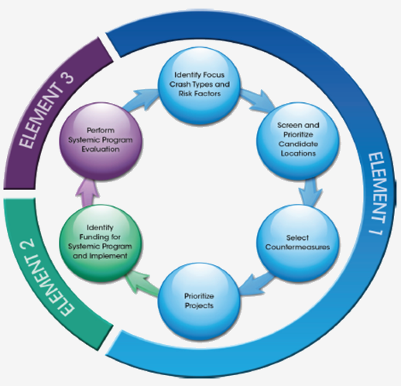
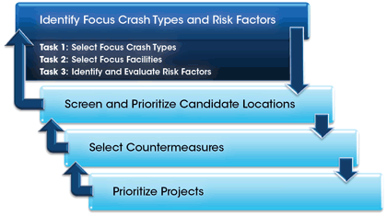
The Systemic Approach
FHWA’s Systemic Approach Program.

Slide 78
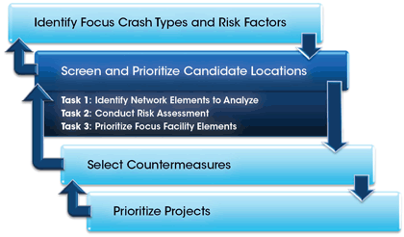
The Systemic Approach
FHWA’s Systemic Approach Program.

Slide 79
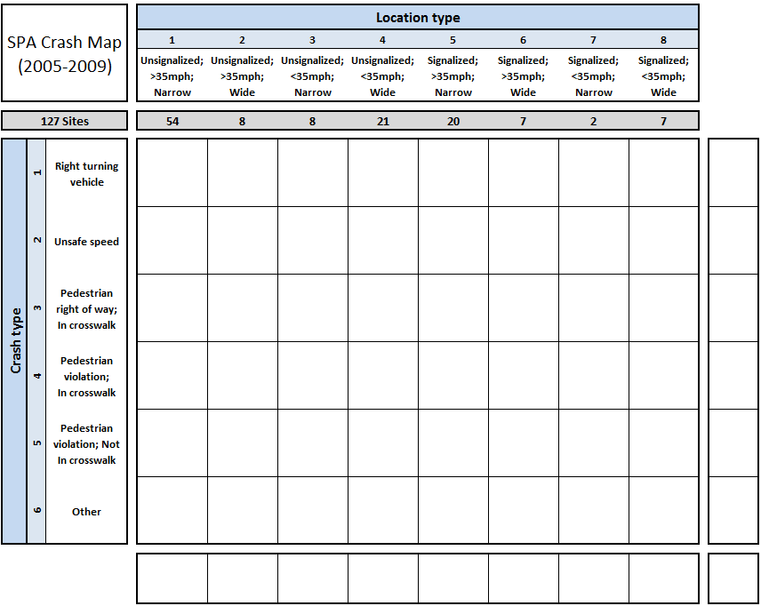
Modified Systemic Approach
Location type is based on features of the site
e.g., Intersection; ADT<10,000; Speed<= 45 mph;Traffic Signal Not present
Crash type is based on features of the crash
e.g., Turning vehicle

Slide 80
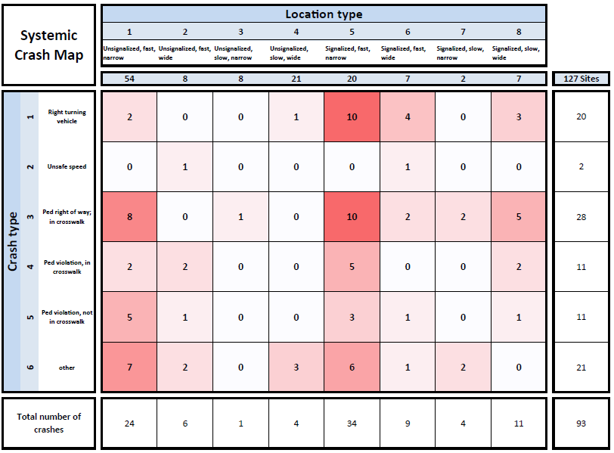
CA Systemic Matrix

Slide 81
CA Systemic Matrix
“Systemic hotspots”

Slide 82
CA Systemic Matrix
Number of sites

Slide 83
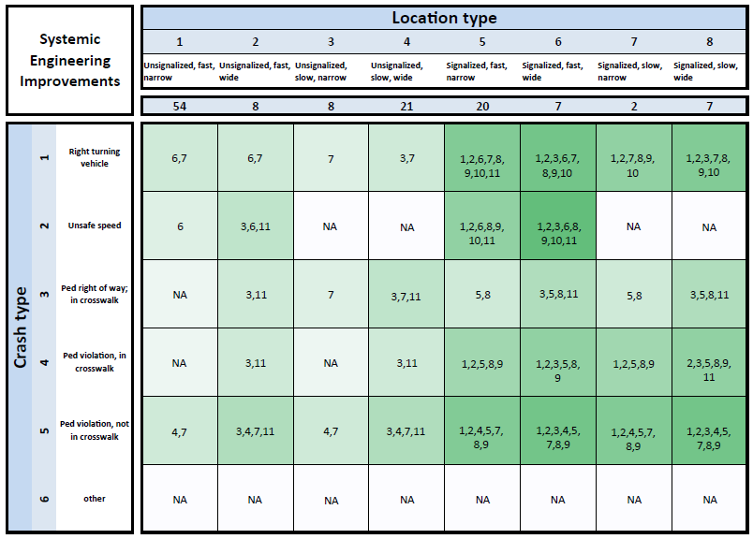
Countermeasure Selection

Slide 84
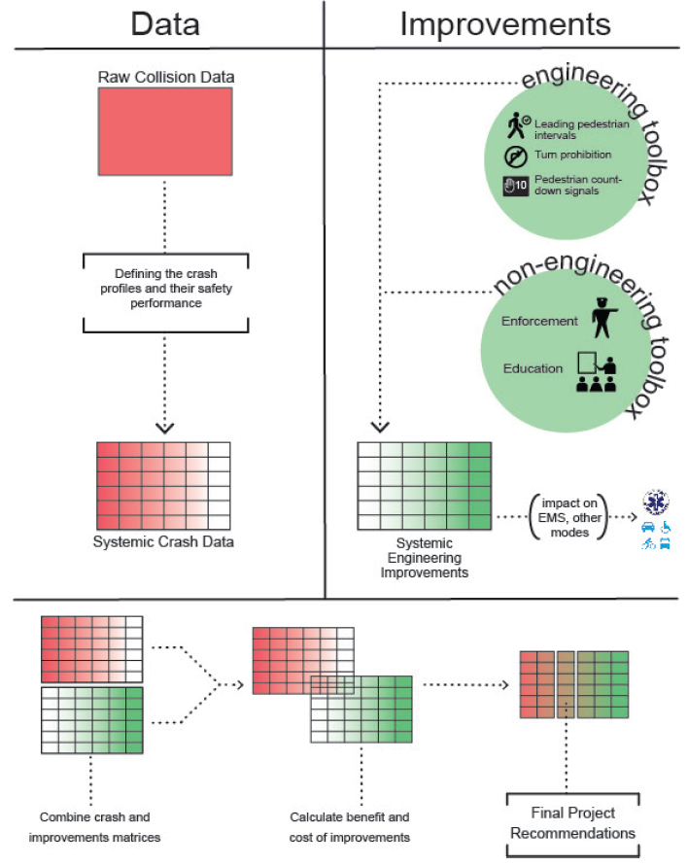
The Systemic Process

Slide 85
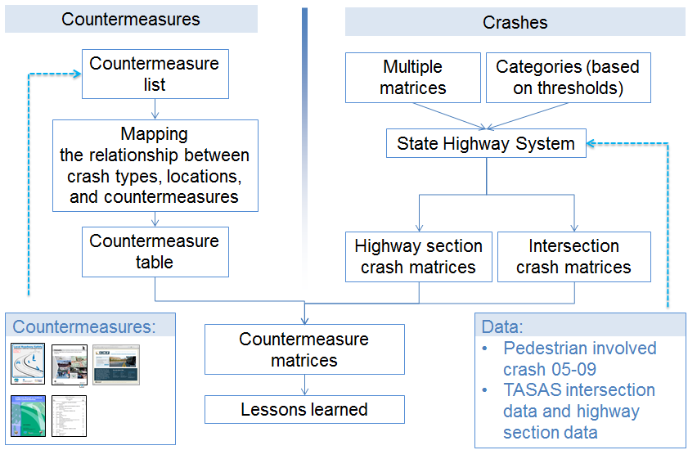
Two sides to the problem

Slide 86
The Systemic Process

Slide 87
Improvements across E’s

Slide 88
Example: Highway crash matrices

Slide 89
Principles of Road Safety Management
 | 1 | 2
3 | 4 | 5
6 | 7 | 8
A set of goals and activities to improve P/B safety | Infrastructure data | Volume data
Data Evaluation | Hazard Assessment | Countermeasure Selection
Economic Appraisal | Funding Sources | Institutionalization

Slide 90
Summary
Why Pedestrians and Bicyclists?
Principles of Road Safety Management
Hazard Assessment Strategies
Hotspot
Systemic
Successful Road Safety Management System

Slide 91
Questions

Slide 92
Road Safety Management System
funding
institutionalization
Volume and infrastructure data
Economic Appraisal
Countermeasures
CRASH data
systemic hotspot
HAZARD ASSESSMENT
Legend
Program core
Inputs
Outputs
Evaluation
Support

